Slide 1

Tata Virtual Internship through Forage Project: Empowering business with effective insights
By
Madhav Kamani

Slide 2
Introduction
Hello and welcome. In this presentation, I will take you through our company's sales performance for the years 2010 and 2011.
I appreciate the opportunity you gave me to dive into this data to gain insightful information about the store's performance.
Thank you also for the questions you asked since they provided a general direction for the kind of insights you are looking to get from this analysis.

Slide 3
Table of contents
Introduction
Thought Process
Revenue by month in 2011
Revenue and Quantity by top 10 Country
Revenue by Customer I’d
Quantity by Country
Recommendations
Conclusion

Slide 4
Thought Process
I assure you that I took all the necessary steps to ensure that this analysis is accurate and correct.
I cleaned up the data you provided by removing all the negative values in the Unit Price and Quantity columns and also filtered the data as required for all the visualizations.

Slide 5
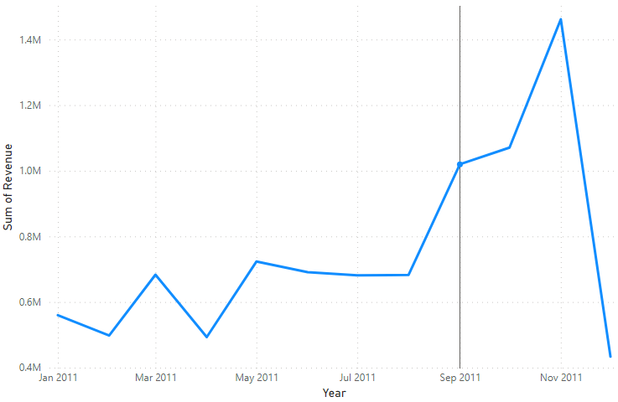
Revenue by month in 2011
The first 8 months had stable monthly revenues with an average of $685,000.
We had a significant increase in revenue from September with the revenue peaking at $1.51 Million in November average of 21.18% increase in revenue from August to November.
The revenue trend from August to December demonstrates how seasonality affects retail store sales.

Slide 6
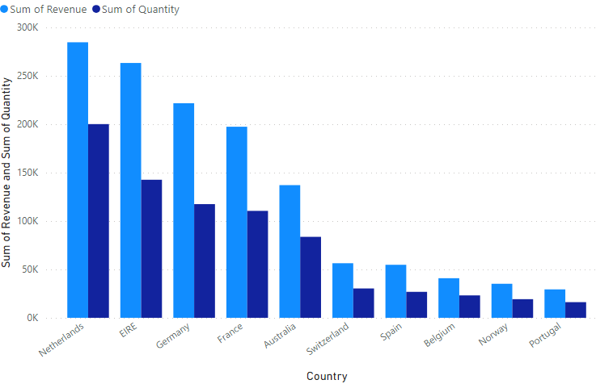
Revenue and Quantity by top 10 country

Slide 7
This chart represents the top 10 countries in revenue and the quantities bought in these countries except The United Kingdom.
There is no major difference between the revenue and the quantity of goods sold in these countries, showing a high purchasing power in these countries.
These countries represent regions with the highest potential to generate more revenue that management needs to focus more on in terms of marketing strategies

Slide 8
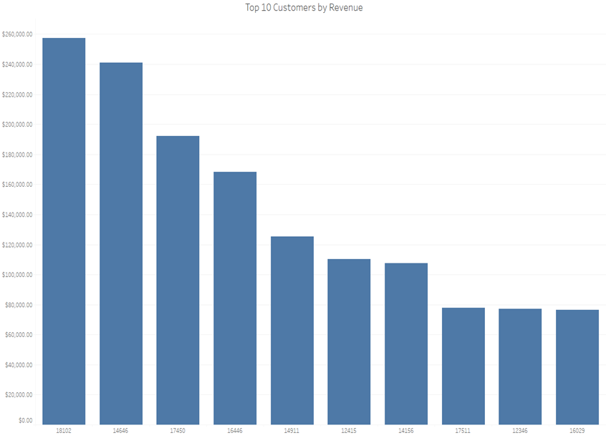
Revenue by Customer I’d
The chart shows that there is no major difference between the top 10 customers in terms of revenue generated.
The average difference in revenue between the top 10 customers is 15.8% The company can aim to strengthen the relationship with these customers to increase customer loyalty and retention, and ultimately drive more sales and revenue for the company.

Slide 9
Sum of Quantity by Country
The map chart concludes by comparing the places that have produced the greatest revenue to those that have not.
The map also reveals that the majority of sales occur only in the European zone, with only a small number in the American region
Along with Russia, there is no market for the items in Africa or Asia.
The company can concentrate on the European market more and dive deeper into countries in the region to come up with strategies that will maximize sales from each country in the region alongside Australia and Japan.

Slide 10
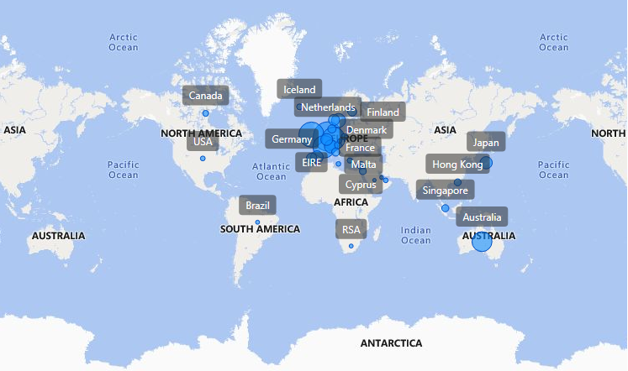

Slide 11
Recommendations
Seasonal Product Strategies: Develop strategies for stocking and advertising seasonal products to maximize sales during peak demand periods. Align inventory management and marketing efforts to capture the seasonal spikes in demand effectively.
Low-Sales Months Analysis: Conduct a deeper analysis of products that experience high demand during traditionally low-sales months. Identify opportunities to market these products more aggressively and increase sales during off-peak periods.
Product Revenue by Region: Dive deeper into the types of products and the revenue generated from these products in each region. This granular analysis will guide region-specific marketing strategies, ensuring that we offer products that resonate with local customers.
Customer Incentives: Consider incentivizing our top revenue-generating customers to strengthen our relationships with them.Loyalty programs, exclusive offers, or personalized experiences can enhance customer retention and drive more business from our key clients.
European Market Focus: Recognizing the European market's growth potential, prioritize strategies that will increase our market positioning within this region. Tailor marketing campaigns, expand product offerings, and explore partnerships to maximize our European market share.

Slide 12
Conclusion
In conclusion, our approach involved data understanding, cleaning, feature engineering, and various analytical techniques to extract valuable insights. We overcame challenges by ensuring data quality and seeking additional context where necessary. This allowed us to present meaningful findings to guide our company's strategic decisions.
By implementing these recommendations, we aim to not only maximize revenue but also enhance customer satisfaction and solidify our market presence. With a strategic focus on seasonality, product analysis, regional strategies, and customer relationships, we are poised for continued growth and success.

Slide 13
Thank You…

